Slide 1

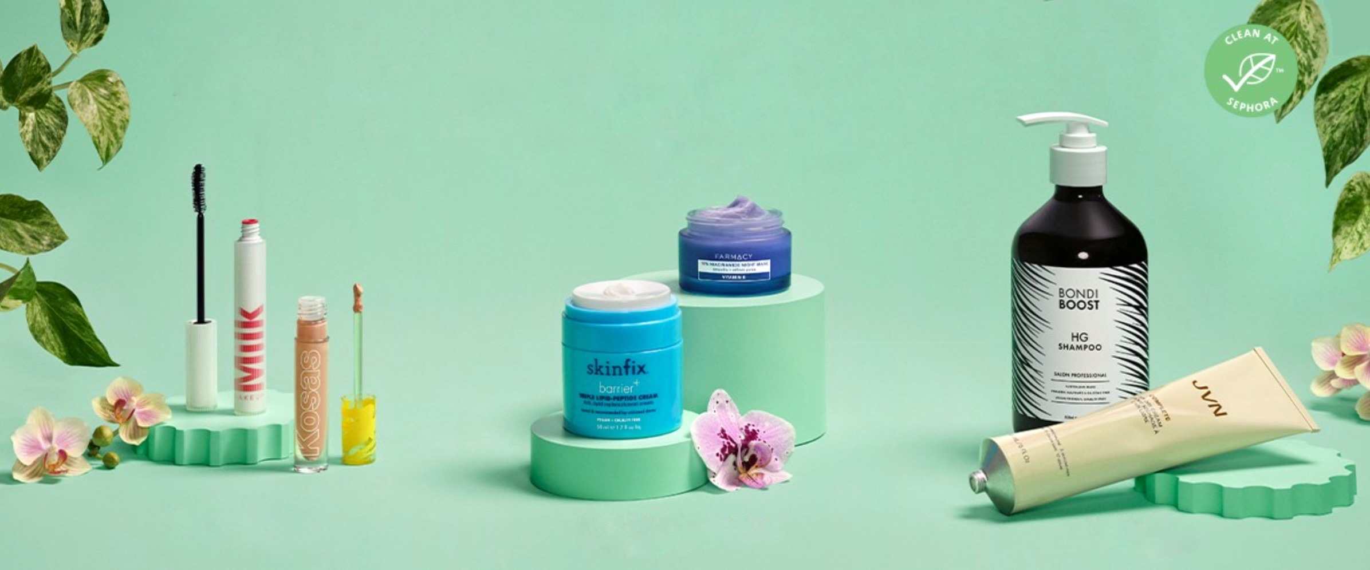
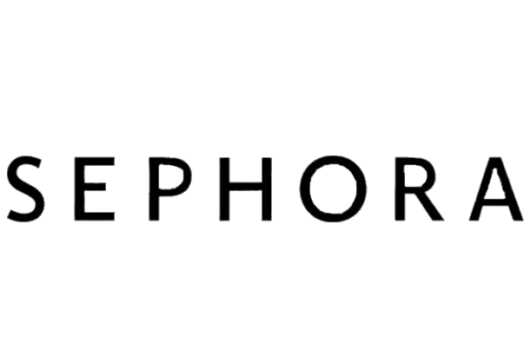

Sephora – Save our Skin!
@Chelsea_Hon
@Aishwarya_Rao
@Nancy_Samuel
@Nehal_Jain
@Fatima_Nadeem
INSY 669 Final Project Presentation
Notes:
Nehal

Slide 2
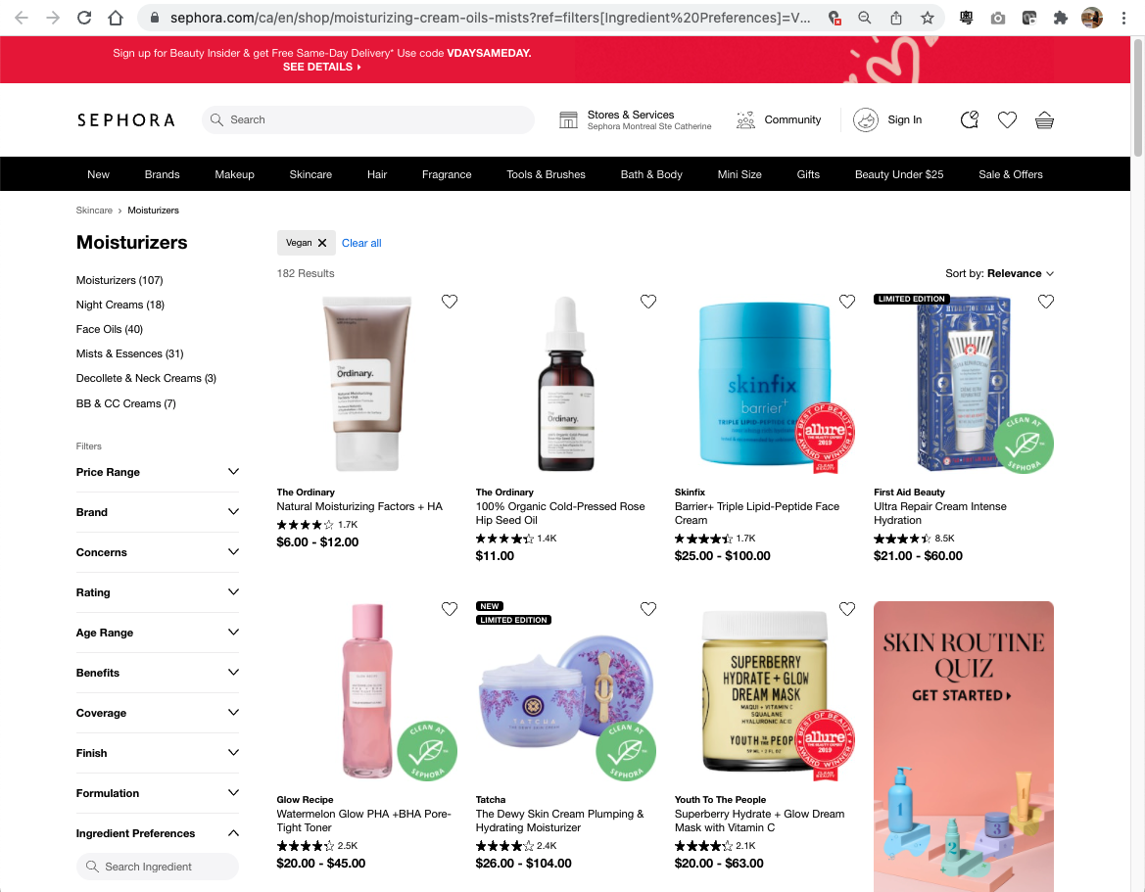


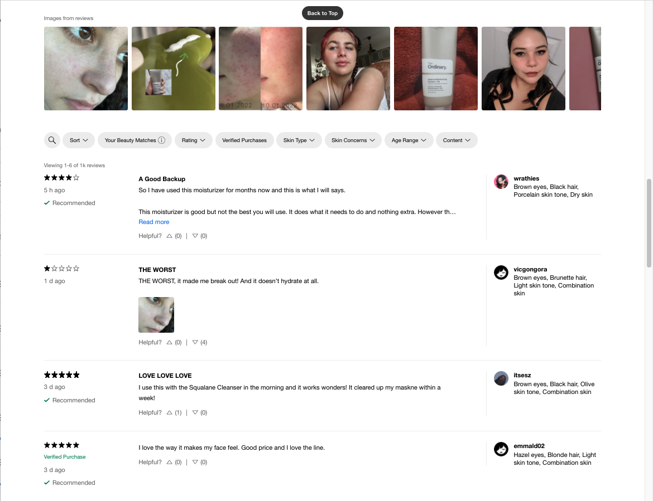


Sorry for my skin
Skin issues dealing with academic stress has driven increasing needs on skincare products among MMAs. Sephora featuring 280+ brands and its own label offers many options – but how we can find the right ones?
Help consumers make better choice with text analytics …
Customers
Lack general purchase guide
Inefficient search by beauty profile attributes filters
Rising interest in vegan/healthy skincare yet unsupported
Sephora
Recommendation based on purchase history
Ratings are indicative yet losing out lots of details
Best reviewed products
MMA4s
Top attributes
Alternatives & bundling
Customer centricity
Notes:
Nehal [1]:
We feel sorry for our skin. Academic Stress has lead to poor skin condition and we are in dire need of good skincare products. There is a growing consumer appetite for Cruelty-Free products and Vegan Skincare is in boom. Where do we find these vegan skincare products? Sephora !!
Sephora is a company operating a chain of personal care and beauty stores with a wide variety of products and brands. It has also a lot of Vegan Skincare products.
But given so many products, we are confused which is the right product for us, given our skin condition and problems and does it actually work?
Beauty Retailers such as Sephora currently recommend products based on past purchased but not for a particular skin type. Rating are also not very helpful to indicate the same.
To solve this problem, we have developed a Review based recommendation system.
We scraped the most recent reviews from Sephora for two main types of vegan products- Moistureizers and Eye Creams. We have collected reviews for 90 such products and analyzed it further in order to find the best match for us.

Slide 3
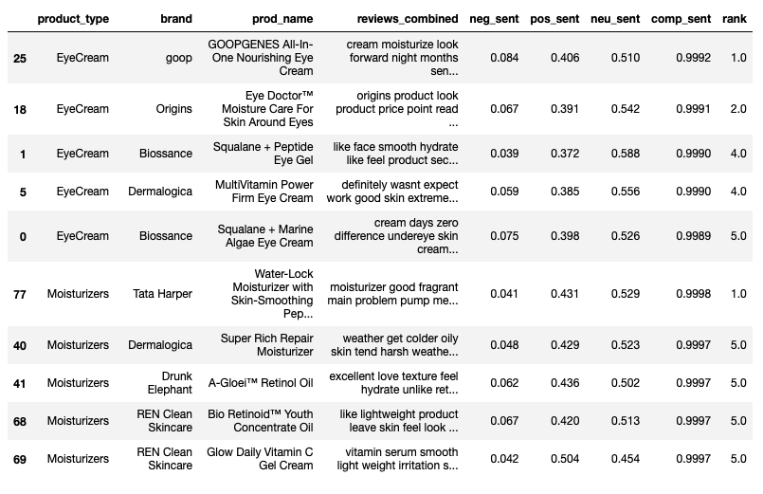
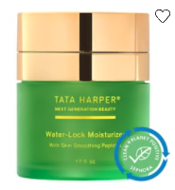
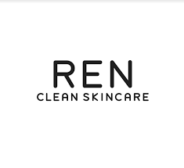
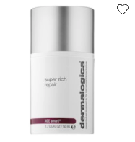
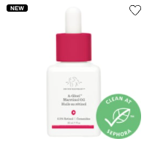
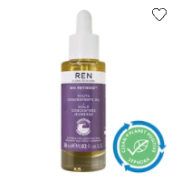
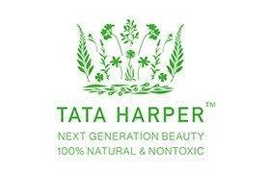

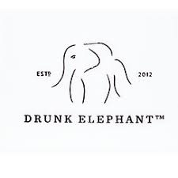
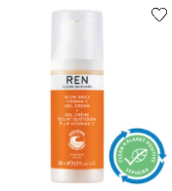


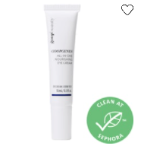
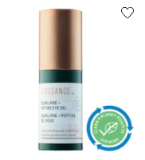
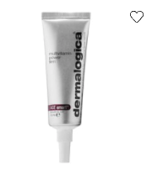
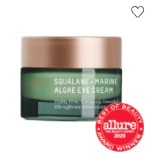
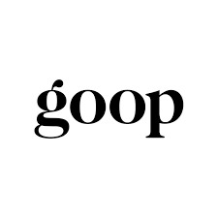
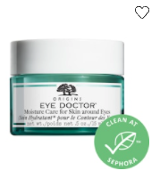
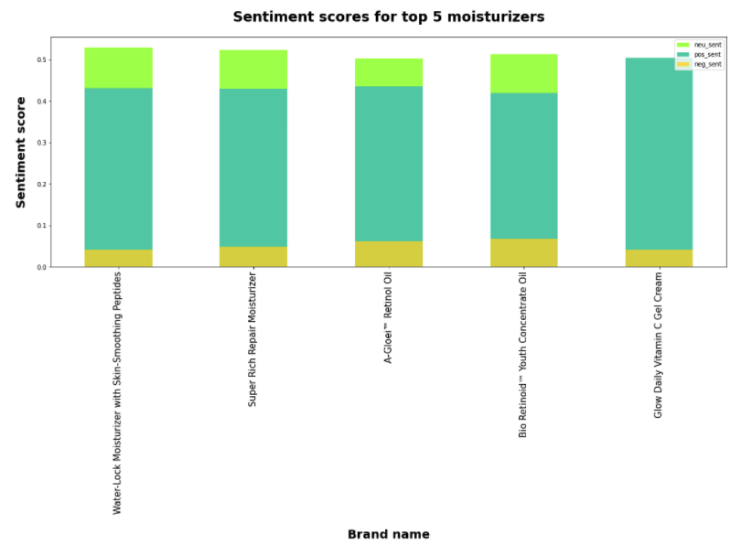
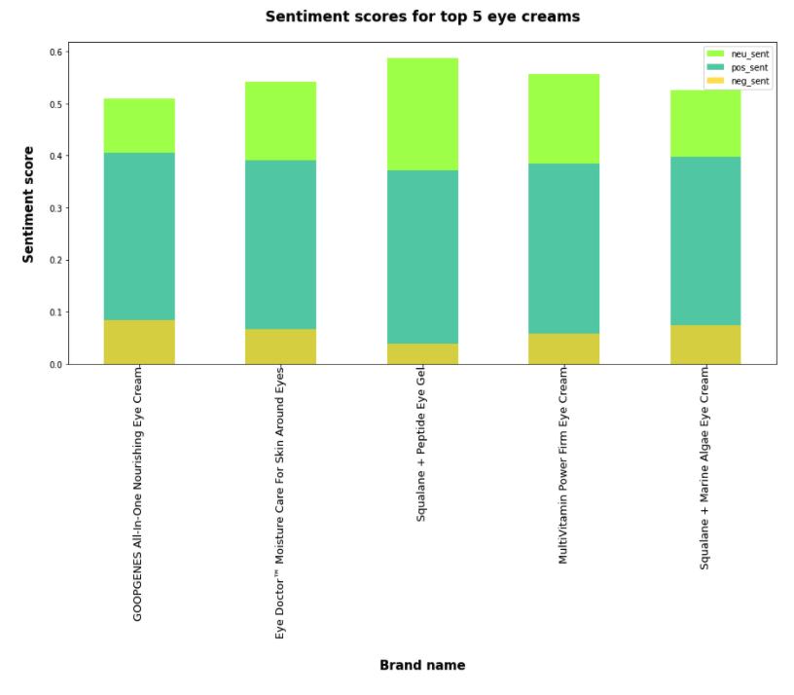

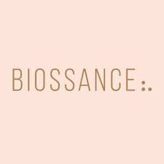
Best reviewed moisturizer & eye-cream
Let’s find out how customers feel about the products through sentiment analysis and find out the top 5 of best reviewed moisturizer & eye-cream for consideration.
Moisturizer
Sentiment Analysis
Sentiment Analysis
#by_ranking
1st
2nd
3rd
4th
5th
Tata Harper
Water-Lock Moisturizer with Skin-Smoothing Peptides
Dermalogica Super Rich Repair Moisturizer
Drunk Elephant A-Gloeiâ, Retinol Oil
Moisturizer
REN Clean Skincare
Bio Retinoidâ Youth Concentrate Oil
REN Clean Skincare
Glow Daily Vitamin C Gel Cream
Eye-cream
1st
2nd
3rd
4th
5th
Goop
GOOPGENES All-In-One Nourishing Eye Cream
Origins
Eye Doctorâ„ Moisture Care For Skin Around Eyes
Biossance Squalane + Peptide Eye Gel
Dermalogica MultiVitamin Power Firm Eye Cream
Biossance Squalane + Marine Algae Eye Cream
Notes:
Product level, brand level (to verify if the same score then average out)
Aishwarya [1]

Slide 4
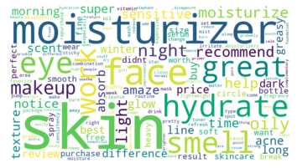








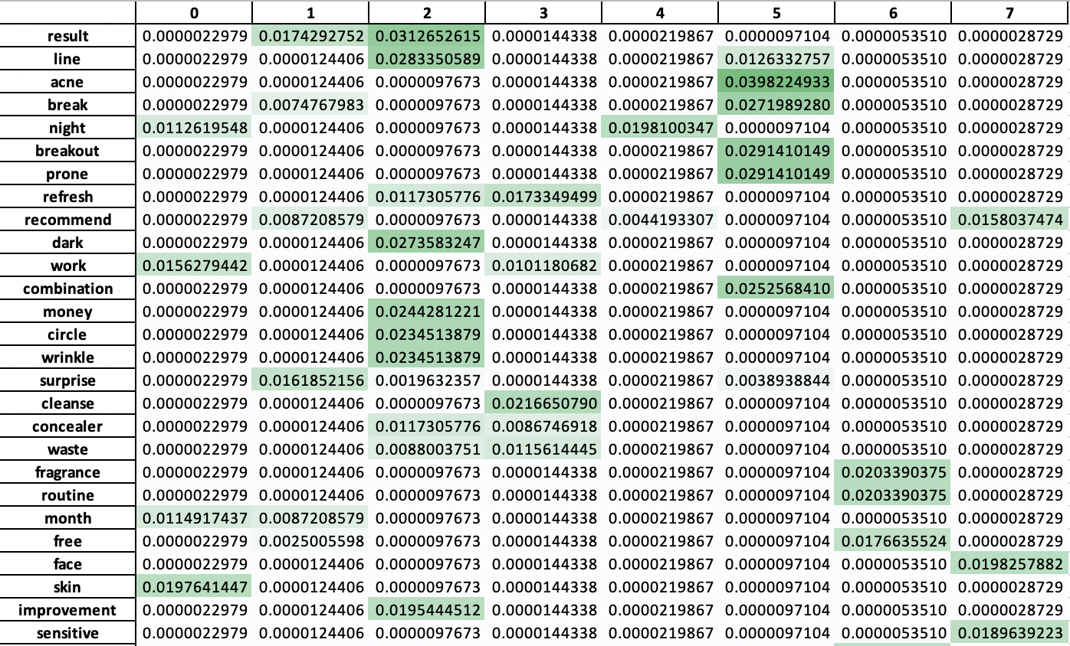
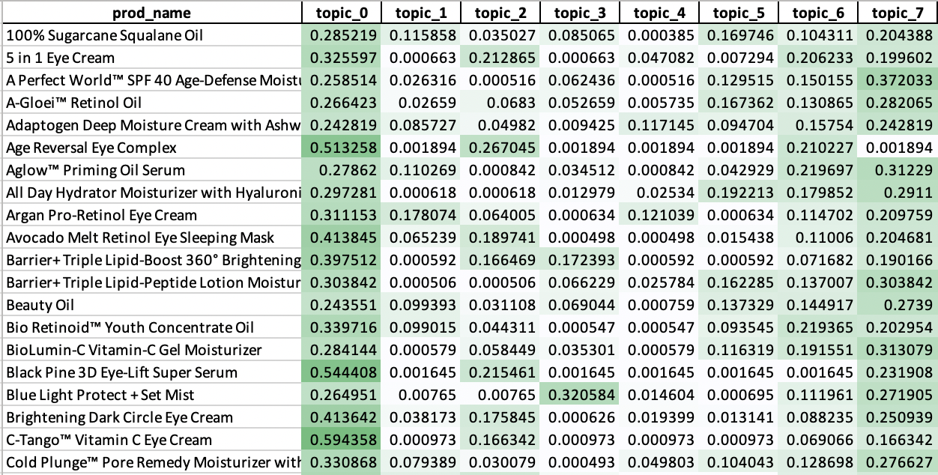
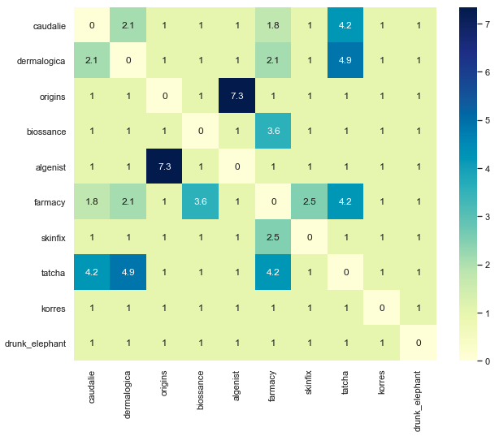
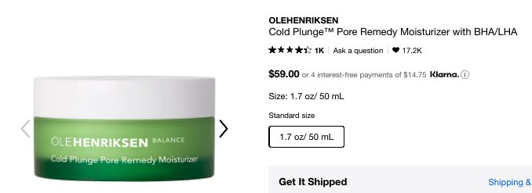
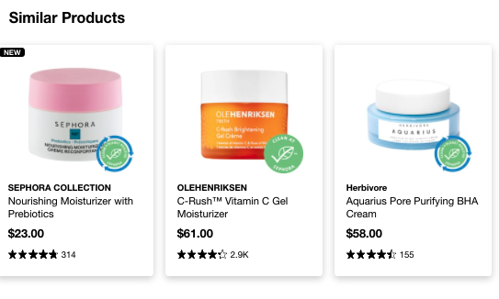
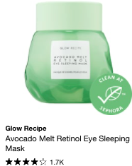
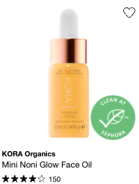
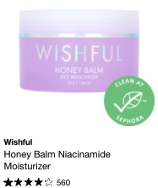
Understanding associations & similarity
(filter: combined sentiment score >= 0.95)
Most Frequently Mentioned Attributes
#by_popularity
Topics Modeling
#by_trending
Top 5 mentioned categories: skincare, emotion, sensational, functional, price
MDS
Top 10 Brands and their Lift Ratios
#by_association
Top 5 mentioned brands are:
Caudalie, Dermalogica, Origins, Biossance, and Algenist
Highest lift ratios in Algenist and Origins, followed by Tatcha with other brands - Dermalogica, Farmacy, Caudalie
Cosine Similarity #by_similarity
Product | Similarity
Cold Plunge™ Pore Remedy Moisturizer with BHA/LHA | 0.2130
Avocado Melt Retinol Eye Sleeping Mask | 0.2086
Noni Glow Face Oil | 0.2079
Honey Balm Niacinamide Moisturizer | 0.2063
Shaba Complex™ Firming Eye Serum | 0.2032
Overnight Glow Dark Spot Sleeping Cream | 0.1976
GENIUS Ultimate Anti-Aging Cream | 0.1957
Resveratrol Lift Firming Cashmere Moisturizer | 0.1930
Adaptogen Deep Moisture Cream with Ashwagandha + Reishi | 0.1918
Virgin Marula Luxury & Face Oil | 0.1906
Notes:
See report for lift ratios by products
Nancy (frequency, topic modelling), [2]
So post our sentiment analysis which only now contains products which have a combined sentiment score>0.95, we also wanted to let our customers know what are the trending topics that other customers are talking about. By count vectorization, we find that it mainly relates to talks about skincare in terms of hydration, sensitivity what are the features of the cream - are they dewy, are they misty, regarding emotion - that they were amazed,if it was nice, i they loved the product and how functional it was in solving their issues like acne, clogged pores etc. So these were our assumptions of the categories, however we wanted to use a more technically structured approach to find the topics that these words are associated to, and topic modelling helps in that. Topic modelling is a type of statistical model for discovering the abstract topics that occur in a collection of documents and to discover it’s hidden semantic structure. And to move forward with our business strategy, we implemented a concept similar to product lines, we would have topic lines which would signify the main categories that people talk about. And since our product is healthy and vegan focussed, we associated these topic lines to the main traits that animals are known for. For example, if you take the topic line pandas, you would find that they are more associated to sleeping, so words like dark circles, puffiness, sleep come in that category. If we talk of the product line fish, we sense an aquatic feeling and words like misty, cleansing come in that category.
For a better understanding of these topic lines, we plotted an interactive MDS which would explain the associations between the different topics and the words inside them.
Fatima (lift, cosine similarity)
We analysed the lift ratios between brands like what we did for previous assignment but acknowledged the fact that brands are less likely to be co-mentioned in reviews under a product. Hence we can only find out that the two brands Aleginst and Origins are mentioned together the most, followed by Tatcha . This more or less gives us a sense on how the key players in vegan skincare interact from a customer's perception.
We also explored cosine similarity between products and reviews to understand consumer behaviour and preference better. This can be further looked into by beauty retailers as potential recommendations for consumers that might be interested in products compared by similarity.

Slide 5
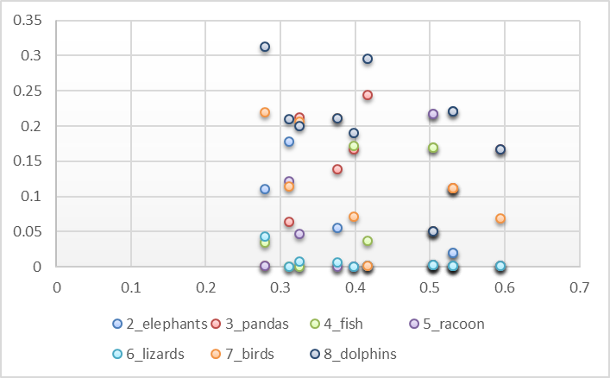
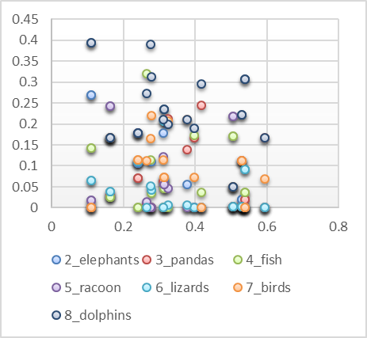
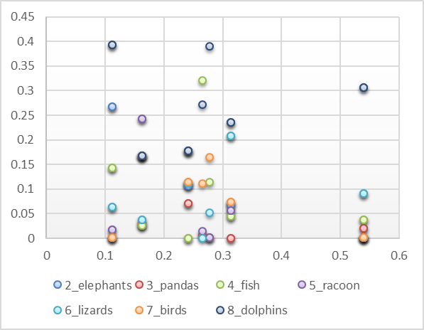

Alternatives/bundles for best outcomes
Crowdsourced recommendation matching products with customer preferences, allows us to consider more attributes than the traditional approach based on order history and review ratings criteria.
#by_relevance
Moisturizers
Eye-creams
Bundle
Product Clustering
Products with similar association for each skin profile will be bundled together as ‘bundle’ recommendations
+
Considerations
Sentiment score >=0.95
Ranking
brand collaborations
Fatima
Dry Skin
To find similar products that suite dry skin - will match related skin profile
Alternative from the same profile cluster
Nancy
Dark Circles
To find the eye-cream to pair with her moisturizer
Bundle of products recommended from overlapping skin profiles
Extension for a particular product type in same cluster
Complementary products bundled based on skin profile
Notes:
Fatima [1]
All analysis done from different perspectives together bring us to our product proposal regarding a recommendation system for customers. It is based on crowdsourced recommendation matching products with customer preferences and allows us to consider more attributes than the traditional approach based on order/cart history and review ratings criteria. After filtering out products by sentiment score, each product’s association with the skin profiles outlined in the topic modelling analysis will be analyzed. Products with similar associations for each skin profile will be bundled together as recommendations. This could be done both as an extension for a particular product type in the same skin profile or as a bundle recommendation comprising of complementary products. Taking two use cases: first of Fatima who wishes to take a route towards healthier skin care for treatment of her dry skin would lie within the elephant skin profile and so all the moisturizers will be ranked by their association with that profile and recommended accordingly. However, Nancy’s case is different as she’s searching for a different product type that is an eye cream which is similar to her moisturizer skin profile. For such scenarios, a bundle of products will be recommended based on overlapping skin profiles and may encompass various brands. Hence, a recommendation system that has been generated which is based wholly on reviews can be immensely helpful for consumers who are not only able to link their skin types with products but also obtain reassurance on the fact that the subsequent matches have been outlined/corroborated by past user experiences . Chelsea will further elaborate on the importance of such an engine from a beauty retailer’s perspective and how it can be implemented

Slide 6
Growth strategies for Sephora
With text analytics as an enabler, we can formulate a customer centric marketing strategy for Sephora in three phases.
Targeted products purchase guide
Educate customers to select right products for their skin daily
User-driven innovation
Focus on R&D and brand collaborations to fill the gaps of customer needs & product offerings
Review-based best skincare awards
Be the most trusted beauty blog and set the trends
Medium-term: nurture
Recommend the right alternatives / bundles products not only based on purchase history but also preferences from user reviews
Long-term: expand
Enjoy product options tailored for our needs and co-create beauty trends for the common good of all beings and our planet
Short-term: gauge
Monthly updated ranking allows customers to explore many new high-quality beauty products
Notes:
Chelsea [1]
with text analytics as an enable, we can formulate a customer centric marketing strategy for Sephora in three phases. In the short term, we want to gauge customer with review-based best skincare awards and be the most trusted beauty blog setting the trend by monthly updated ranking so customer can explore many new high-quality beauty products. In medium term, Sephora shall nurture their customers through targeted recommendations on the right alternatives/bundled products, not simply based on purchase history but also user reviews. Ultimately, customer centricity can be achieved by user-driven innovation and this is not bounded by Sephora platform but extendable to the industry trend. Companies need to focus on R&D and brand collaborations so as the fill the gaps in the previous slide. Customers can enjoy more product options which tailored to their need and co-create the beauty brand food the common good of all beings and our planet. That’s the end of our presentation and I hope all of you can now get an idea of where to start with to find the right products for ourselves.

Slide 7
Thank You

Slide 8
Appendix - Sentiment Analysis
back to slide

Slide 9
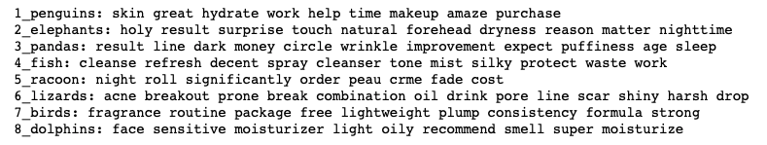
Appendix - Topic Modelling

Slide 10
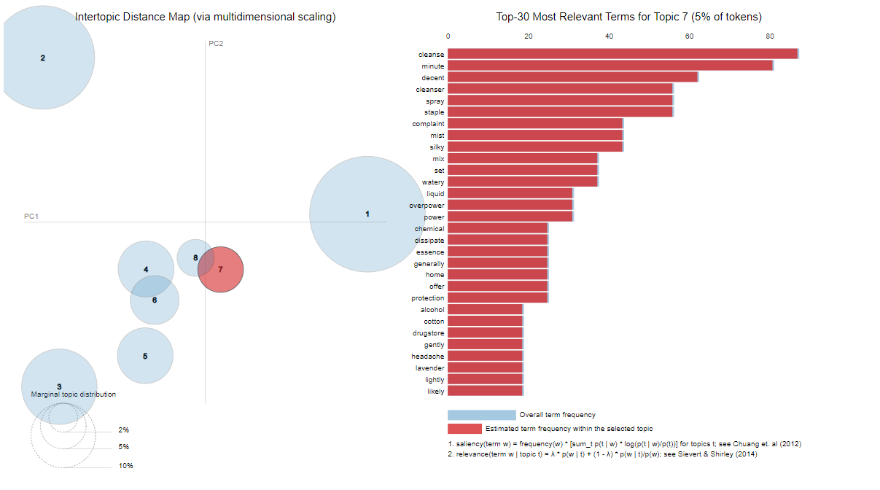
Appendix - Topic Modelling MDS Word frequency in topic modelling for topic line ‘Fish’ which contains words like cleanse, mist etc
back to slide

Slide 11
Appendix - Topic Product Association
1_penguins
8_dolphins
4_fish
'100% Sugarcane Squalane Oil',
'5 in 1 Eye Cream',
'Adaptogen Deep Moisture Cream with Ashwagandha + Reishi',
'Age Reversal Eye Complex',
'All Day Hydrator Moisturizer with Hyaluronic Acid',
'Argan Pro-Retinol Eye Cream',
'Avocado Melt Retinol Eye Sleeping Mask',
'Barrier+ Triple Lipid-Boost 360° Brightening Eye Cream',
'Barrier+ Triple Lipid-Peptide Lotion Moisturizer',
'Bio Retinoid™ Youth Concentrate Oil',
'Black Pine 3D Eye-Lift Super Serum',
'Brightening Dark Circle Eye Cream',
'C-Tango™ Vitamin C Eye Cream',
'Cold Plunge™ Pore Remedy Moisturizer with BHA/LHA',
'Cooling Water',
'Dew It All Total Eye Cream',
'Dream Eye Cream with Vitamin C and Ceramides',
'Equilibrium™ Intensive Hydrating Eye Balm',
'Eye Doctor™ Moisture Care For Skin Around Eyes',
'Flash Nap Instant Revival Priming Eye Gel-Cream',
'GENIUS Ultimate Anti-Aging Cream',
'GOOPGENES All-In-One Nourishing Eye Cream',
'Glow Daily Vitamin C Gel Cream',
'Grape Water Moisturizing Face Mist',
'Hyaluronic Eye Cream',
'Jasmine Green Tea Oil Control Toner',
'Keep Young And Beautiful™ Instant Brightening Beauty Shot Eye Lift',
'Keep Young and Beautiful Anti-Aging Eye Cream',
'Lala Retro™ Whipped Moisturizer with Ceramides',
'Lite Sauce Clean Balancing Gel Moisturizer with Ceramides',
'Mini Barrier+ Triple Lipid-Peptide Face Cream',
'Mini Lapis Blue Tansy Face Oil - For Oily &amp; Acne-Prone Skin',
'MultiVitamin Power Firm Eye Cream',
'My Clarins RE-FRESH roll-on eye de-puffer',
'Noni Glow Face Oil',
'Overnight Glow Dark Spot Sleeping Cream',
'Overnight Restorative Cream',
'Plantscription™ Anti-Aging Power Eye Cream',
'Preserve the Serve Luminous Setting Spray',
'Protini™ Polypeptide Moisturizer',
'Resveratrol Lift Firming Cashmere Moisturizer',
'Resveratrol Lift Firming Eye Gel-Cream',
'Resveratrol Lift Firming Night Moisturizer',
'SUPERWATERGEL Triple Acid Oil-Free Moisturizer',
'Screen Break Blue Light + Anti Pollution Protection Mist',
'Shaba Complex™ Firming Eye Serum',
'Squalane + Marine Algae Eye Cream',
'Squalane + Omega Repair Moisturizer',
'Squalane + Peptide Eye Gel',
'Stress Positive Eye Lift Mask',
'Super Rich Repair Moisturizer',
'Superberry Hydrate + Glow Dream Mask with Vitamin C',
'Superberry Hydrate + Glow Dream Oil',
'The Water Cream Oil-Free Pore Minimizing Moisturizer',
'Vegan Milk Moisturizer',
'Vinoperfect Instant Brightening Moisturizer with Niacinamide',
'Virgin Marula Luxury&nbsp; Face Oil',
'Vitamin C+ Collagen Brighten &amp; Firm Eye Cream',
'Water-Lock Moisturizer with Skin-Smoothing Peptides']
'A Perfect World™ SPF 40 Age-Defense Moisturizer with White Tea',
'A-Gloei™ Retinol Oil',
'Aglow™ Priming Oil Serum',
'Beauty Oil',
'BioLumin-C Vitamin-C Gel Moisturizer',
'Cream Skin Toner &amp; Moisturizer',
'Daily Repairing Moisturizer',
'Dailyscreen Moisturizer SPF 40 PA+++',
'Dr. Andrew Weil For Origins™ Mega-Mushroom Relief &amp; Resilience Soothing Treatment Lotion',
'GLOWSETTER™ Makeup Setting Spray',
'GinZing™ Oil- Free Energy Boosting Gel Moisturizer',
'Honey Halo Ultra-Hydrating Ceramide Moisturizer',
'Hydration Replenish Microencapsulated Plumping Gel Moisturizer',
'Maracuja Hydrating Tinted Moisturizer',
'Skin Dope Argan + Hemp Oil',
'Squalane + Antioxidant Cleansing Oil',
'Squalane + Hyaluronic Toning Mist',
'Superfood Air-Whip Moisturizer with Hyaluronic Acid',
'Ultra Repair® Oat &amp; Hemp Seed Dry Oil',
'Vinoclean Makeup Removing Cleansing Oil',
'Vinopure Oil-Control Moisturizer for Acne Prone Skin',
'Vitamin C Suspension 23% + HA Spheres 2%',
'Watermelon + AHA Glow Sleeping Mask',
'Watermelon Pink Juice Oil-Free Moisturizer',
'Wild Rose Night-Brightening Sleeping Facial'
'Blue Light Protect + Set Mist'

